Slide 1
Preclinical Trials: Ayurvedic Perspective

Slide 2
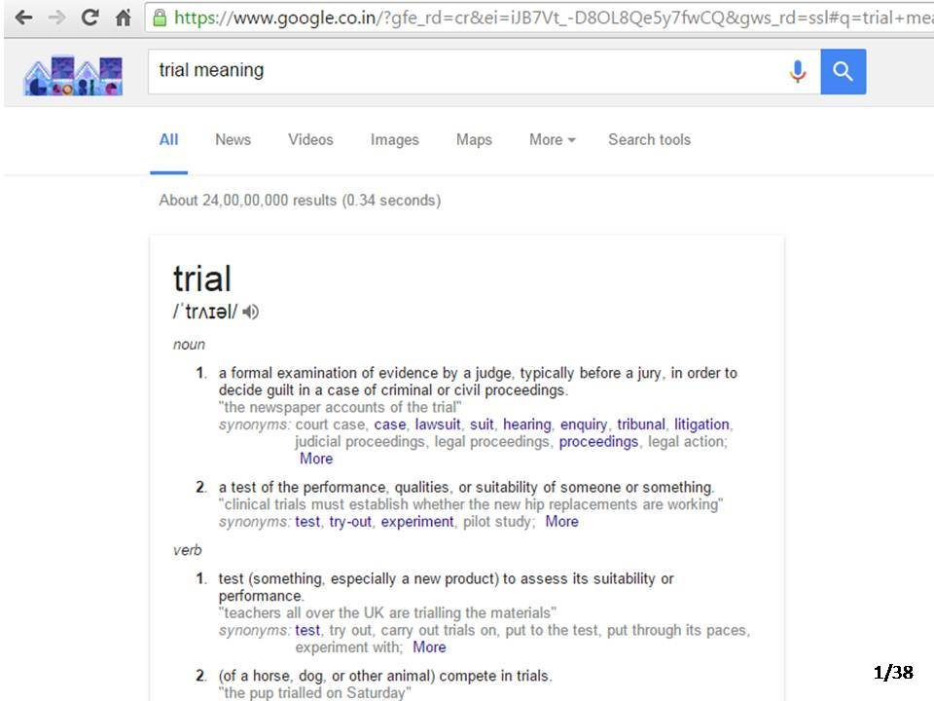

Slide 39
Thank You

